Slide 1

GOVERNOR
Governor adds, removes and updates
personnel and inmates.
Also, he/she regulates the jobs of the personnel.

Slide 2
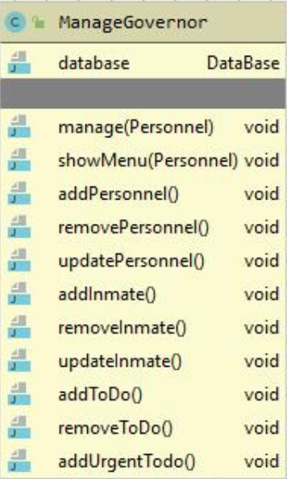
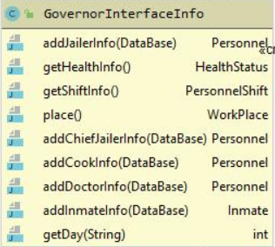
Database hold the Personnel list as SKIP LIST. Governor adds, deletes and updates personnel using this skip list.
Database hold the Inmates as AVLTree. Governor adds, removes and updates inmates using this AVLTREE.
Database hold to-do’s two different types. Todos that was done before keeps as a LIST. Others keeps as a PRIORITYQUE.

Slide 3
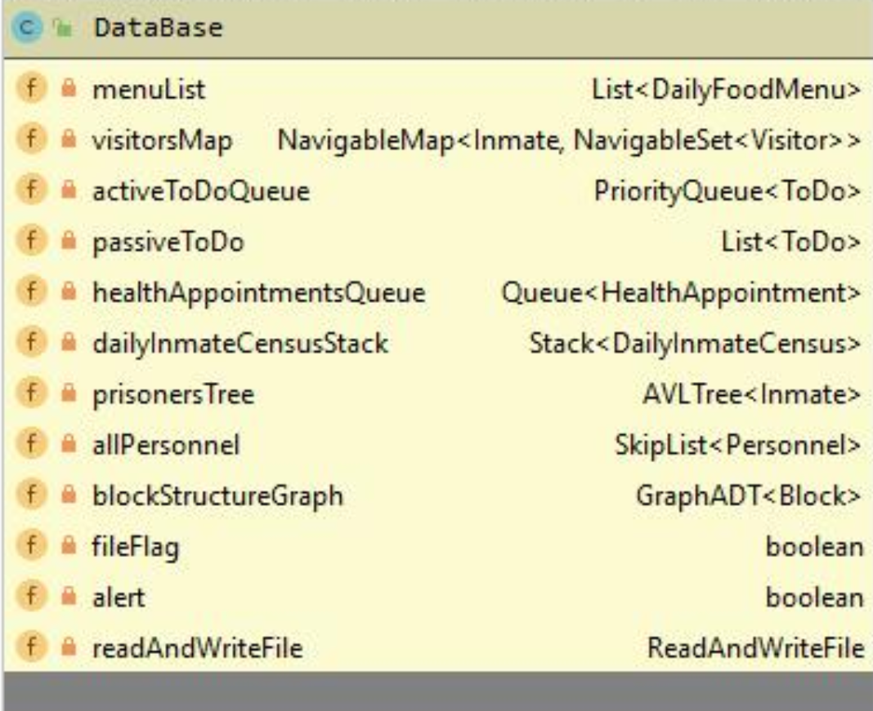
The reason of the using AVLTree for keeping inmate, we can search an inmate in O(logn) time. The reason of the using PriorityQueue for keeping personnel’s tasks, personnel must do must important job to the other jobs. The reason of the using Skip List sor keeping personnel, we can search a personnel in O(logn) time and it provide us a fast search while password checking.

Slide 4
addPersonnel method adds personel in Skip List.
deletePersonnel method removes personel in SkipList.
updatePersonnel method updates personel informations.
In all these methods,
If the personel is not available, the program gives an error.
addInmate method adds inmate in AVLTree.
removeInmate method removes inmate in AVLTree.
updateInmate method updates inmates informations.
In all these methods,
If the inmate is not available, the program gives an error.
addToDo method adds to-do in priority queue.
removeToDo method removes to-do in priority queue. Removed to-do adds passive to-do list.
addUrgentToDo method adds urgent to-do. the importance of these jobs is greater than others.
In all these methods,
If the to-do is not available, the program gives an error.

